Slide 1

Branch Predictor - Analysis
CS6304 Project 1
Simulation & Benchmarking using 3 Standard Predictors
Vignesh & Jigishaa

Slide 2
Contents
What is Branch Predictor ?
Need for a Branch Predictor ?
3 Types of Branch Predictor
Gem5
gem5 Introduction
gem5 Setup
gem5 Configurations
Building gem5
Benchmark Setup
Understanding the simulation
Simulation
Local Predictor & Analysis
BiMod Predictor & Analysis
Tournament Predictor & Analysis
Comparing all Branch Predictors
Challenges

Slide 3
What is a Branch Predictor ?
Branch Predictor is used to predict the next Address of the instruction (IP)
Basic things needed during prediction:
If it’s a branch instruction
Possible branch direction
Branch target address – if taken
A look up table to hold the previous values (commonly known as BTB – Branch Target Buffer or Branch History Table)
Based on the principle of Spatial & Temporal Locality, we can help the CPU to predict the next instruction
Mis predict recovery mechanism – incase the predicted value is wrong.
Footer information

Slide 4
Need for Branch Predictor ?
Improves the performance during branch instruction execution in pipelining
The CPU doesn’t need to stall by waiting to compute the next instruction to be executed
Improve the flow in the instruction pipeline.
Footer information

Slide 5
3 types of Branch Predictor
1. Local Branch predictor :
A 2-bit predictor that has a separate history buffer for each conditional jump instruction.
It uses two-level adaptive predictor.
Trade off- Predictor is simple to implement.
Generally, miss prediction rates are higher.
2. BiMode Branch predictor :
A Global Behavioural Branch Predictor that eliminates destructive aliasing in global history indexed schemes.
It is more considered to be efficient than local branch predictor; since it uses two level of prediction history
Trade off - mis prediction are comparatively low than local branch predictor. But strict tradeoff between area and energy.
3. Tournament Branch Predictor :
It is the Combined/Hybrid Predictor.
There are two different predictors maintained, one based on global information, and one based on local information, and the option of the predictor is based on a selection strategy.
Trade off - Involves complex circuitry.
Predictor needs more area to implement

Slide 6
gem5 Introduction
gem5 is a modular discrete event driven computer system simulator platform.
Primarily written in C++ & python, which allows capabilities to write our own custom modules for more complex simulations
gem5 has 3 main Branch Predictors.
Local Predictor
BiMod Predictor
Tournament Predictor

Slide 7
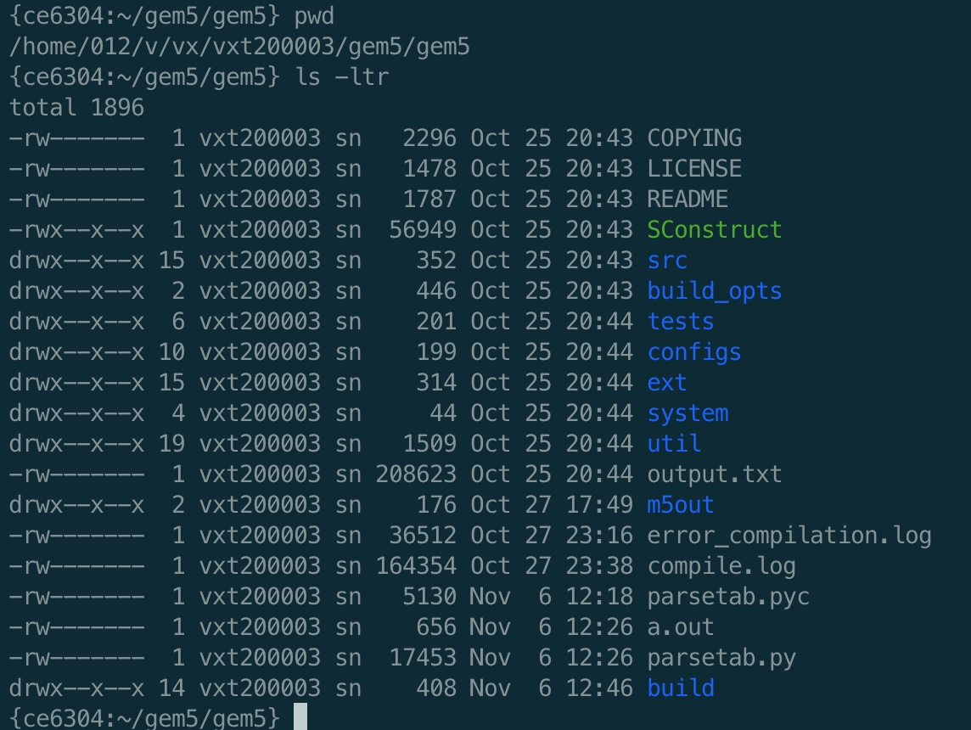
gem5 Setup
Used the gem5 available on the ce6304 VM
Access to the machine: (NET ID Access with VPN only)
ssh <netid>@ce6304.utdallas.edu
Copied gem5 to our home dir
cp –rvf /usr/local/gem5 ~/gem5

Slide 8
gem5 Configurations
To add Branch Predictor support – $gem_home/src/cpu/simple/BaseSimpleCPU.py
Replace the NULL as LocalBP() / BiModBP() / TournamentBP() one by one and work on it
Adding Predictor based configurations
Update the predictor size @ $gem_home/src/cpu/pred/BranchPredictor.py
Adding custom parameters
Add custom code to files for additional stats (added to the project submission) $gem_home/src/cpu/pred/bpred_unit.cc
$gem_home/src/cpu/pred/bpred_unit.hh
$gem_home/src/cpu/simple/base.cc
$gem_home/src/cpu/simple/exec_context.hh

Slide 9
A Sample Configuration

Slide 10
Building gem5
We will use scons to build the project (configured)
scons build/X86/gem5.opt -j5
gem5. opt = binary we will be building
5 represents the parallel resources (use atleast 5)
“lscpu” - will give the of vcpu & other configs of the server
Alternatives for opt:
opt – optimized
perf - to calculate the performance numbers
fast - bunch of simulations
debug - no optimizations

Slide 11
Benchmark Setup
Benchmark an Industrial standard way to compare performance of systems
Unified way of comparing systems – like apple-to-apple comparison
Clone the benchmark provided in the project to HOME Dir git clone https://github.com/timberjack/Project1_SPEC.git
Update the timing & instruction parameters
time $GEM5_DIR/build/X86/gem5.opt -d $OUT_DIR $GEM5_DIR/configs/example/se.py -c $BENCHMARK -o "$ARGUMENT" -I 500000000 --cpu-type=timing --caches --l2cache --l1d_size=128kB --l1i_size=128kB --l2_size=1MB --l1d_assoc=2 --l1i_assoc=2 --l2_assoc=4 --cacheline_size=64

Slide 12
Understanding the Simulation
time $GEM5_DIR/build/X86/gem5.opt \ # use the scons built output
-d $OUT_DIR $GEM5_DIR/configs/example/se.py \ $ using a Standard System written in python
-c $BENCHMARK \ # represents the benchmark to be used (468 / 470)
-o "$ARGUMENT” \ - # custom arguments
-I 500000000 \ # number of Instructions to run the benchmark (500MM)
--cpu-type=timing \ # can be atomic / timing / Simple CPU Time
--caches \ # cache configuration – will not affect the simulation & benchmarking
--l2cache --l1d_size=128kB --l1i_size=128kB --l2_size=1MB --l1d_assoc=2 --l1i_assoc=2 --l2_assoc=4 --cacheline_size=64

Slide 13
Simulation
https://github.com/vigneshkmr84/cs-6304-project1

Slide 14
Local predictor

Slide 15
Local Predictor Analysis
470 Benchmarking
Changing BTB values doesn't have impact to the Branch Prediction outcome
BTB Mis Prediction decreases with increase in predictor size (from 1024 to 2048)
Companies Marketing teams might not prefer to use Benchmarks, since it gives not favorable results
458 Benchmarking
Changing BTB values doesn't have any major impact to the prediction - there are 0.005% changes, that is not evidential;
Increasing the Predictor size increases the BTB prediction percentage ~ 0.003% but decreases the Branch Mis prediction by ~0.0005%
These changes are so minimal that for 500MM instructions ~ 2500 instructions are mis-predicted
On high level – BTB size doesn’t affect both the Prediction outcome; So, we can use a Smaller BTB Size and reduce area and complexity of implementation

Slide 16
BiMod Predictor – Benchmark 458
BTB 4096
BTB 2048

Slide 17
BiMod Predictor – Benchmark 470
BTB 4096
BTB 2048
For Increease in

Slide 18
BiMod Predictor Analysis – 458 Benchmark
For Constant BTB increase in global increases the misprediction
BTB change is not affecting the Branch Prediction outcome. (~ with few delta variations)
Change in global increases Branch Mis Prediction, but decreases BTB Mis prediction
For Constant Global Predictor size, change in choice Predictor doesn’t have any impact on Branch Mis Prediction; but has slight variations in BTB Mis-Prediction

Slide 19
BiMod Predictor Analysis – 470 Benchmark
For Constant BTB increase in global increases the misprediction, but decreases BTB Mis prediction
BTB change is not affecting the Branch Prediction outcome. (~ few delta variations)
For Constant Global Predictor size, change in choice Predictor Slightly increases the Branch Mis Prediction

Slide 20
Tournament Predictor - Benchmark 470
BTB MISSpct
BTB 4096
BTB 2048

Slide 21
Tournament Predictor - Benchmark 458
BTB 4096
BTB 2048

Slide 22
Need for Branch Predictor ?
470
BTB Mis prediction increases as the local value increases but is independent of the other Global / Choice predictors (but the increase is very small ~ 0.05%)
Branch Mis Prediction as we ll follows the same pattern
458
BTB Mis prediction increases as the local value decreases but is independent of the other Global / Choice predictors (but the increase is extremely small ~ 0.00005%, can be neglected )
Branch Mis Prediction increases slightly with 0.0005% , again can be neglected)
Increase in Local Predictor size is having the change; ignoring the Choice & Global Predictor values
Footer information

Slide 23
Tournament Predictor Comparison
470
BTB Mis prediction increases as the local value increases but is independent of the other Global / Choice predictors (but the increase is very small ~ 0.05%)
Branch Mis Prediction as we ll follows the same pattern
Change in Local Predictor size is affecting the Branch Prediction changes; ignoring the Choice & Global Predictor values
458
BTB Mis prediction increases as the local value decreases but is independent of the other Global / Choice predictors (but the increase is extremely small ~ 0.00005%, can be neglected )
Branch Mis Prediction increases slightly with 0.0005% , again can be neglected)
Increase in Local Predictor size is having the change; ignoring the Choice & Global Predictor values
We can see that the tournament predictor is having a similar impact of choosing more of Local Predictor over BiMod predictor;

Slide 24
Comparing All Branch Predictors
Based on the comparison, we can see that the 458 benchmarking shows similar results to that of theoretical understanding – where Tournament having less mi predictions
While 470 shows that Local Predictor has slightly better compared to Tournament.
In both 470 & 458, bimod is having poor mis prediction percentage compared to the others
We propose the systems to go with Tournament predictor, since they are having the least mis predictions for both the benchmarking standards; as well tournament predictor depends mostly on local predictor.
Additionally, keeping the choice, and predictor size less will give better results as well reduce area and complexity

Slide 25
Challenges
Understanding gem5 took some time; but referred documentations and videos for basic understanding
Running the simulation was very lengthy – each run approx. took 20 mins (for the scons build)
We have automated using Unix script to run for the specific configurations
localBP.sh
tournament.sh
biMod.sh
We missed to clean up build up directory; but rectified by deleting the complete build/X86 folder & re-ran again

Slide 26

Thank you

